Slide 1
Advanced Modeling for Distribution Planning with OpenDSS
Instructor
Roger C. Dugan Sr. Technical Executive Sacramento, California June 22-23, 2017

Slide 2

Instructor
Roger C. Dugan, Life Fellow, IEEE
Roger is a Sr. Technical Executive with EPRI in Knoxville, Tennessee USA. He has over 45 years of combined experience in distribution engineering with EPRI, Electrotek Concepts, and Cooper Power Systems. He holds the BSEE degree from Ohio University and the Master of Engineering in Electric Power Engineering degree from Rensselaer Polytechnic Institute, Troy, NY. Roger has worked on many diverse aspects of power engineering over his career because of his interests in applying computer methods to power system simulation. Beginning with a student internship with Columbus and Southern Ohio Electric Co, his work has been focused on Distribution Engineering. He was elected a Fellow of the IEEE for his contributions in harmonics and transients analysis. Recently, he has been very active in distributed generation, particularly as it applies to utility distribution systems and distribution system analysis. He was the 2005 recipient of the IEEE Excellence in Distribution Engineering Award. He is coauthor of Electrical Power Systems Quality published by McGraw-Hill, now in its 3rd edition. He serves on the IEEE PES Distribution System Analysis Subcommittee and is active in the Distribution Test Feeders WG.

Slide 3
Control Elements

Slide 4
Control Elements Were an Important Part of the Original DSS Model Concept

Slide 5
Controls
A key feature is that controls are modeled separately from the devices being controlled
Capacitors
Regulators/tapchangers
Control Modes
Static
Power flows with large time steps
Time
Control queue employed to delay actions
Control acts when time is reached
Event

Slide 6
OpenDSS Solution Loop with Controls
Controls are sampled and executed after a converged power flow solution
Power Flow Solution
Control Sampling

Slide 7
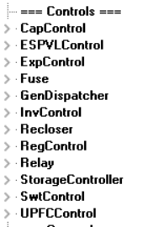
Available Control Elements

Slide 8
Shunt Capacitors
The kvar rating
The kV rating
L-L for 3-phase bank in OpenDSS
Rating of can for 1-phase capacitors
Switching criteria
None (fixed)
Voltage
Current
kvar (plus Voltage Override, Delay, etc)
PF
Time

Slide 9
OpenDSS Capacitor Model
Shunt Capacitor is actually a multi-step filter bank
Is a 2-terminal PD element, so may be used as a Series Capacitor also

Slide 10
Shunt Capacitors - CapControl
The control is modeled separately from the Capacitor
Type
{Current | voltage | kvar | PF | time }
PT ratio
CT ratio
Time Delay, Delay OFF, Dead time
Voltage override
User model (optional)

Slide 11
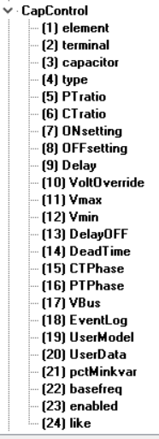
CapControl Element Properties
Monitored Element
Controlled Element

Slide 12
Voltage Regulator/OLTC
Voltage target
Bandwidth
Time Delay
PT ratio
CT primary rating (regulator rating)
Line-drop compensator (forward and reverse)
R (in Volts!)
X
Remote bus to control

Slide 13
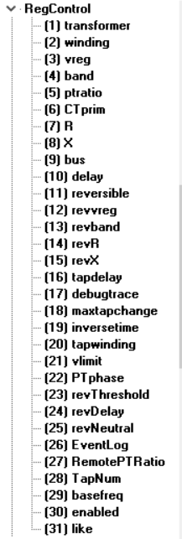
RegControl Element Properties
Monitored and Controlled Transformer Winding
Remote Bus Monitoring (Optional)

Slide 14
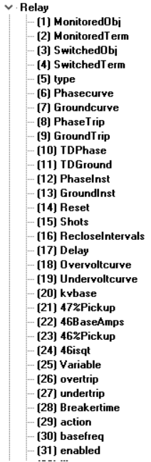
Relay Control (Multifunction Relay)
A Relay object can monitor current (and voltage) in one device terminal and control the switch in any other terminal

Slide 15
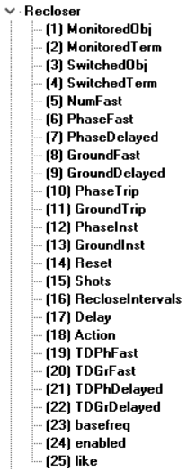
Recloser Control
Similar to a RELAY except terminology and behavior different

Slide 16
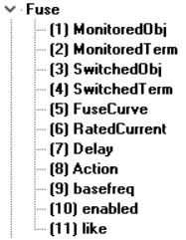
Fuse Control
Klink and Tlink are defined for each new circuit
To use: Simply define a Fuse Object and specify Monitored object and, optionally, Switched object
For Fuse objects, the Switched Object is the same as the Monitored Object in nearly all cases.

Slide 17
StorageController
Time + Discharge rate Peak Shaving Load Following Loadshape
Discharge Mode Charge Mode kW Target Discharge Time Total Fleet kW Capacity Total Fleet kWh
et. al.
Comm Link
V, I
Substation
Storage “Fleet”

Slide 18
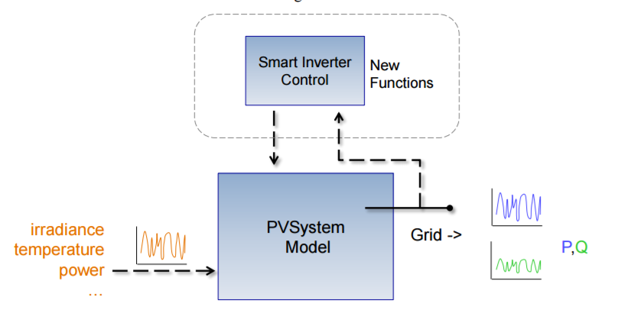
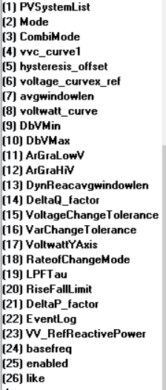
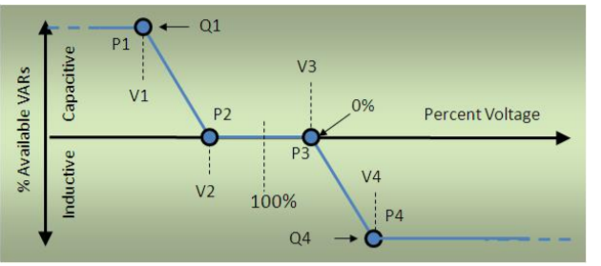
InvControl
New XYCurve.vv_curve npts=4 Yarray=(1.0,1.0,-1.0,-1.0) ~ XArray=(0.5,0.95,1.05,1.5)
New InvControl.InvPVCtrl mode=VOLTVAR voltage_curvex_ref=rated ~ vvc_curve1=vv_curve EventLog=yes

